Slide 1
Multi-Task Learning
Natural Language Processing
(based on revision of Richard Socher Lectures)

Slide 2
Suggested Readings
The Natural Language Decathlon: Multitask Learning as Question Answering

Slide 3
Evolution of NLP (or AI in general)
Linguistics (2000)
Machine Learning with feature engineering (2000-2010)
Deep Learning with feature engineering (2010-2015)
End-to-End Deep Learning (2015 - 2017)
Large Pretrained Model (Transfer Learning) (2017-present)
?

Slide 4
Main limitations of current approach
Limited to only single task and not robust at all (unlike humans)
Multi-Task Learning
Assuming a lot of data
Meta Learning (next class)
Lack of model understanding
More fundamental analysis
Lack of good evaluation
Come up with better metric; use human judgement when possible

Slide 5
A unified model for NLP?
Einstein wants to find a unified theory of this universe but fail to
Can we create a unified NLP model?
The first question to answer is to how to frame many NLP tasks in the same framework?
Sequence tagging: NER, POS
Text classification: sentiment analysis, natural language inference
Seq2seq: summarization, QA, dialogue, MT

Slide 6
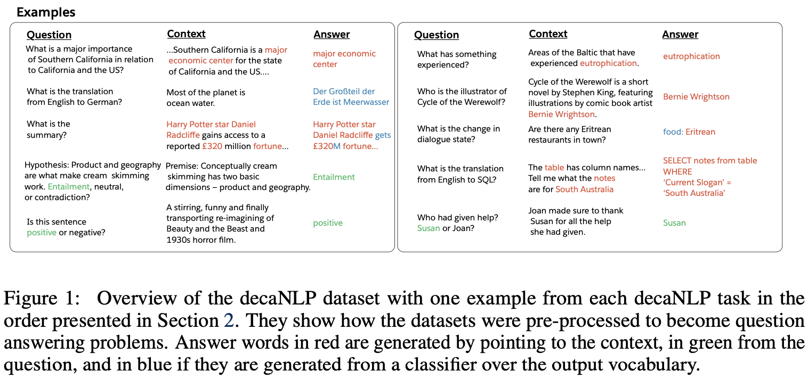
The Natural Language Decathlon (decaNLP)

Slide 7
Multitask Learning as QA
Question Answering MT Summarization Natural Language Inference Sentiment Classification | Semantic Role Labeling Relation Extraction Dialogue Semantic Parsing Commonsense Reasoning
Meta-Supervised Learning: From {x, y} to {x, t, y} (t is the task)
Use a question, q, as a natural description of the task, t, to allow the model to use linguistic information to connect tasks
y is the answer to q and x is the context necessary to answer q
Note that since no explicit task ID is given, it forces the model to internally figure out the task

Slide 8
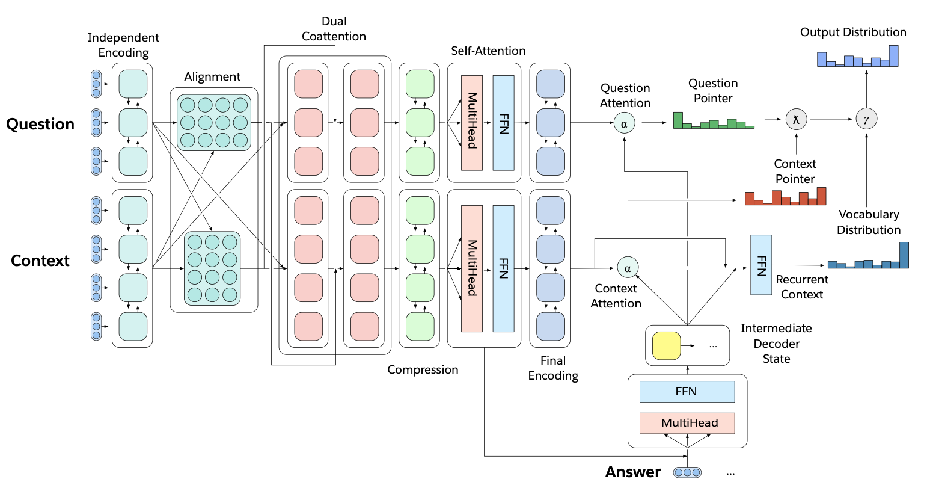
decaNLP - Multitask Question Answering Network (MQAN)

Slide 9
decaNLP - Multitask Question Answering Network (MQAN)
Fixed Glove + Character n-gram embeddings -> Linear -> Shared BiLSTM with skip conn.

Slide 10
decaNLP - Multitask Question Answering Network (MQAN)
Two-way attention (similar to BiDAF) between question and context representations.

Slide 11
decaNLP - Multitask Question Answering Network (MQAN)
BiLSTMs to reduce dimensionality, two transformer layers, another biLSTM to reduce dim.

Slide 12
decaNLP - Multitask Question Answering Network (MQAN)
Auto-regressive decoder use the final concatenation of the context and question state to get the answers

Slide 13
MQAN
Gamma decides whether to copy or select from an external vocabulary, lambda decides whether to copy from context or question
Gamma, beta, lambda are sigmoids, used to determine whether to copy or generate….

Slide 14
Evaluation
Evaluation | Dataset | Metric
Question Answering MT Summarization Natural Language Inference Sentiment Analysis Semantic Role Labeling Relation Extraction Dialogue Semantic Parsing Commonsense Reasoning | SQuAD IWSLT En - De CNN/DailyMail MultiNLI SST2 QA-SRL QA-ZRE WOZ WikiSQL Winograd Schemas | nF1 BLEU ROUGE EM EM nF1 cF1 dsEM IfEM EM
nF1 = normalized word-level F1, ROUGE = average of ROUGE-1,2, and L
EM = exact match, cF1 = corpus level F1, dsEM = dialogue state EM, lfEM = logical form EM
Note that in this paper, they sum all these metrics

Slide 15
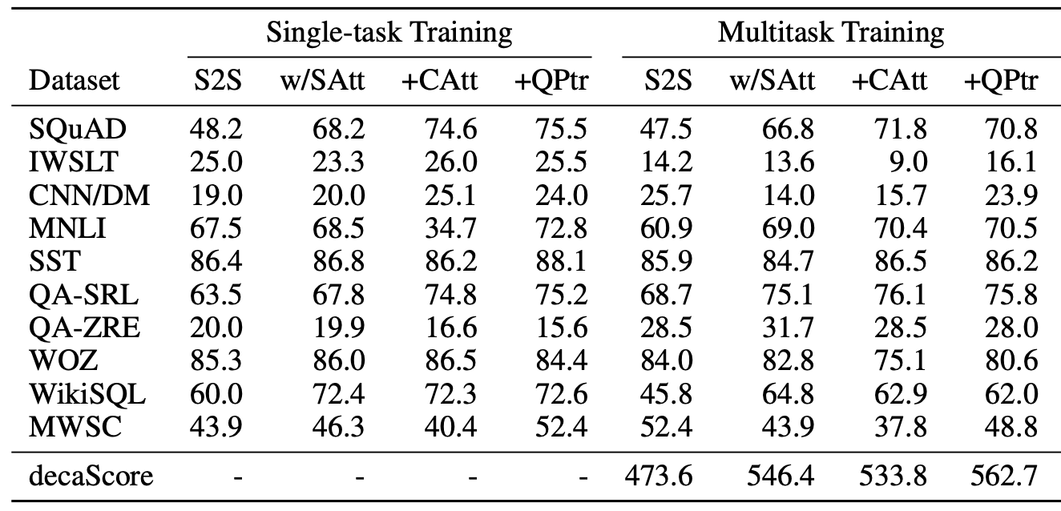
Evaluation
S2S = Seq2Seq
+SelfAtt = plus self attention
+CoAtt = plus coattention
+QPtr = plus question pointer

Slide 16
Evaluation
Attention (+Att) is important in most tasks
Pointer (+QPtr) is important in some tasks
Multitasking help zero shot! (see QA-ZRE)
Generally, single-task is still better than multi-task learning

Slide 17
So how to further improve?
The author proposed that perhaps we should train more difficult tasks more!
Normally, what we do:
Batch 1: Task 1, Batch 2: Task 2, etc. in a round-robin fashion
Instead, we propose training more difficult tasks more, for example:
Batch 1: Task 1 (the most difficult task), Batch 2: Task 2 (the next difficult task), then Batch 3: Task 1 again, Batch 4: Task 2, Batch 5: Task 3 (easier task), Batch 6: Task 4 (easier task), etc.
They called this Anti-Curriculum Pre-training
The paper choses SQuAD as the task, since this is a Q&A task after all….

Slide 18
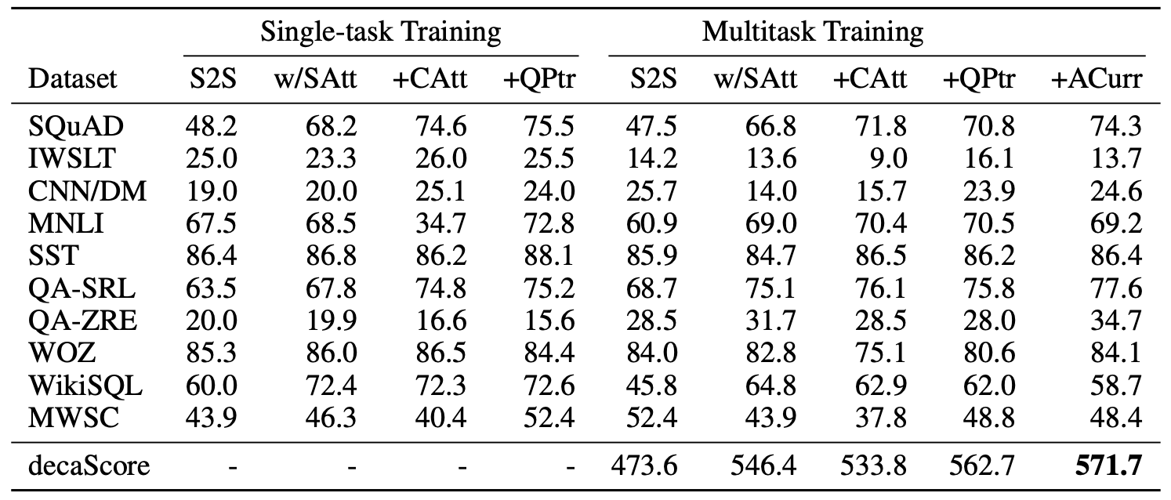
Evaluation
Improves on some tasks, but still not really obvious improvements…., especially IWSLT

Slide 19
So how to further improve?
Increase the score to 593 with CoVe (instead of GloVe)
Everybody increases…
CoVe is like Elmo, it is a context vectors produced by MT-LSTM
Increase the score to 609 by including more tasks such as MT during the anti-curriculum pretraining
Increase the score to 617 by oversampling on IWSLT (every batch has machine translation)
IWSLT score 21.4
CNN/DailyMail score 23.8
QA-ZRE score 47.0

Slide 20
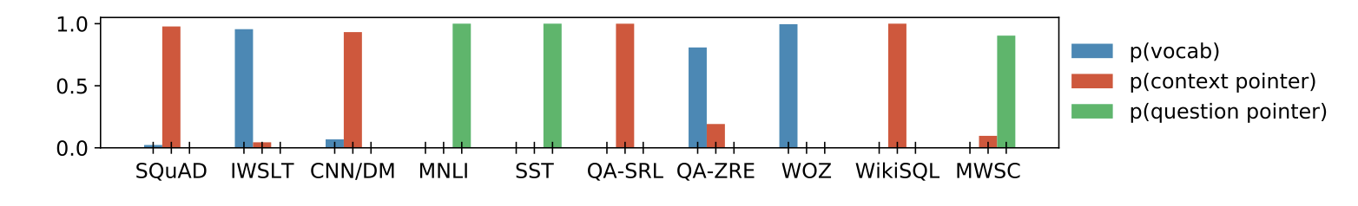
Does the network understand what tasks?
Answers are correctly copied from either context or question, for example,
IWSLT is a MT task, thus generate from vocab
SST is a sentiment analysis task, but it copies the answer from question, because the question asked “Is it positive or negative”
No confusion over which task

Slide 21
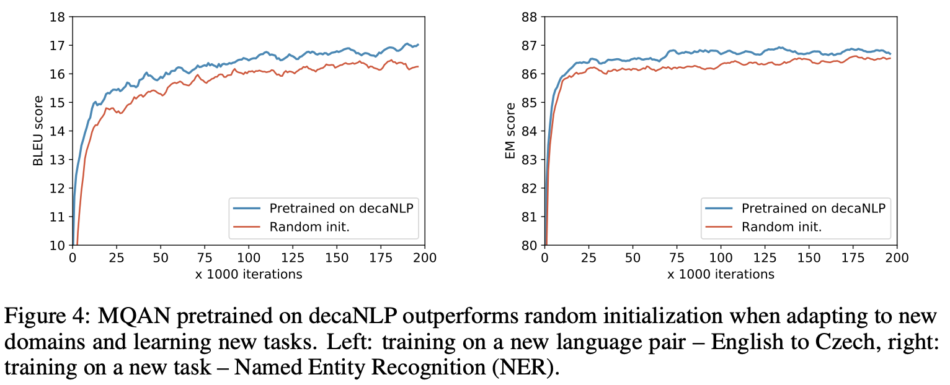
Generalization to other tasks
For e.g., another IWSLT language pairs
Or new tasks like named entity recognition

Slide 22
Adaptation to similar tasks
Because MNLI is included in decaNLP, it is possible to adapt to the related Stanford Natural Language Inference Corpus (SNLI).
Fine-tuning a MQAN pretrained on decaNLP achieves an 87% exact match score, which is a 2 point increase over training from a random initialization and 2 points from the state of the art.
Without any fine-tuning on SNLI, a MQAN pretrained on decaNLP still achieves an exact match score of 62%.
Because decaNLP contains SST, it can also perform well on other binary sentiment classification tasks. On Amazon and Yelp reviews, a MQAN pretrained on decaNLP achieves exact match scores of 82.1% and 80.8%, respectively, without any fine-tuning.

Slide 23
Summary
Multi-task model treats all tasks as one task
Aims to (1) bring better generalization to new tasks, and (2) zero shot domain adaptation to similar tasks
Got to make all tasks the same; lots of preprocessing; data balancing
How you prepare the batch and samples between task appears very important
Word embedding still seem useful here!!! Gotta try ELMo….the author uses CoVE since the score for MT is very poor.
Pointer is nice mechanisms to differentiate between tasks
Another popular multi-task NLP model is T5 (they do many interesting experiments so definitely check out for inspiration)

